Slide 1

A New Look and Feel for the Graduate School Application
Aaron Pearson
Technical Specialist

Slide 2
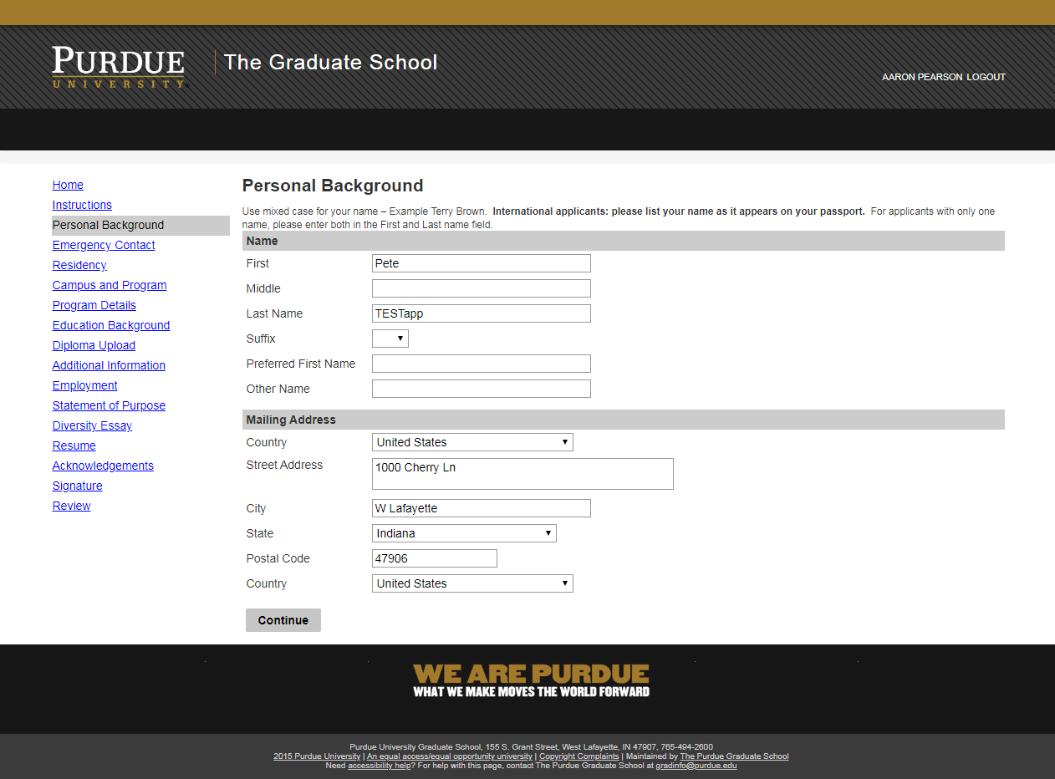
The Old Look and Feel for the Graduate School Application

Slide 4
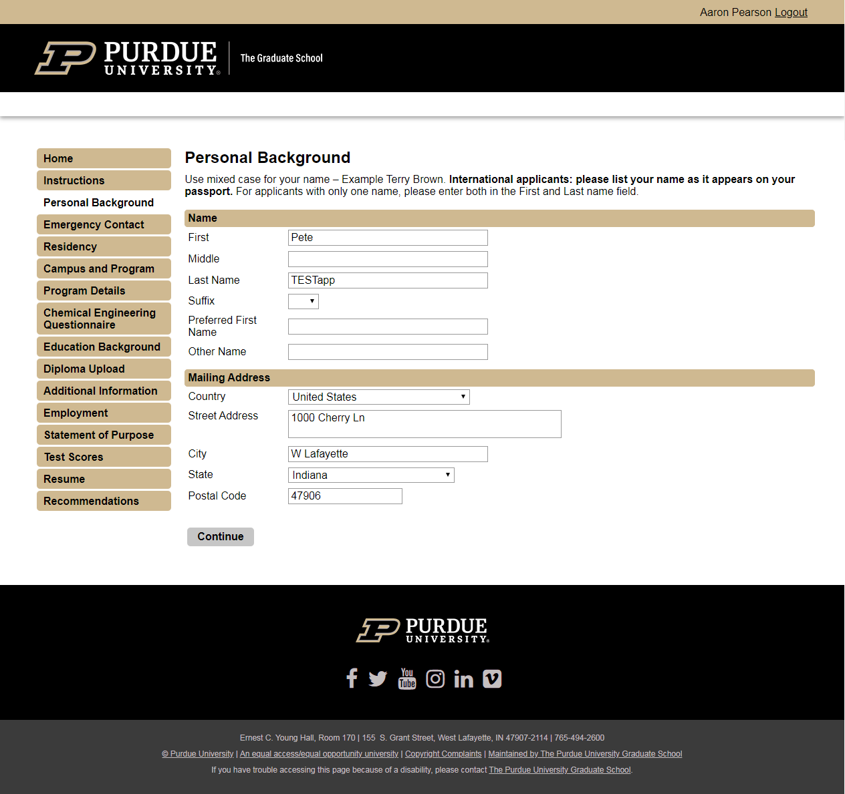
A New Look and Feel for the Graduate School Application

Slide 6
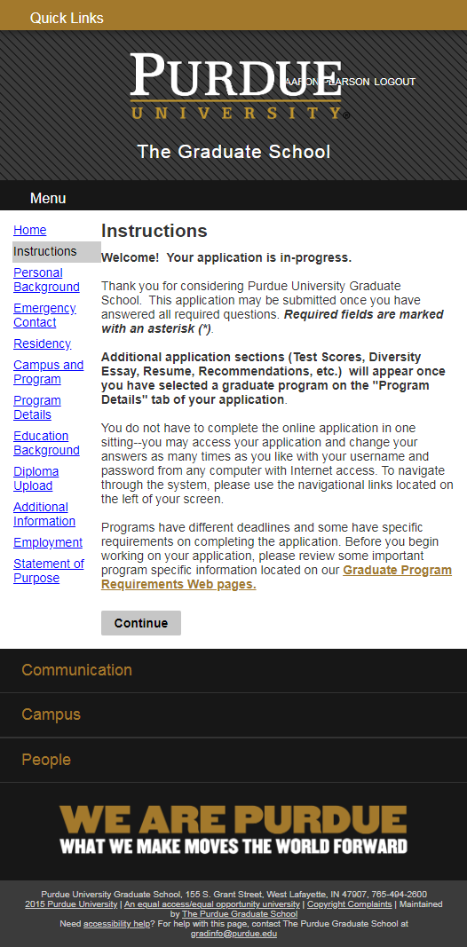
The Old Look and Feel for the Graduate School Application

Slide 8
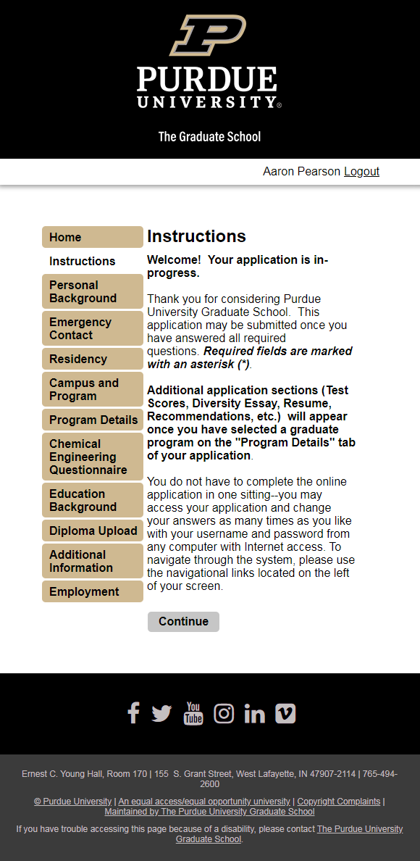
A New Look and Feel for the Graduate School Application

